Slide 1
Lab 7

Slide 2
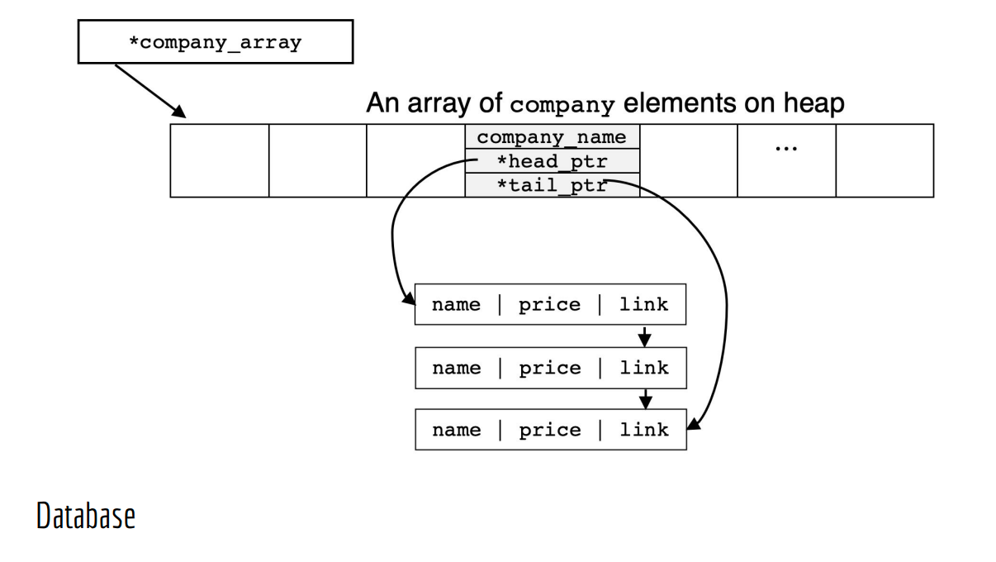

Slide 3
Node
One node of a linked list
One product and link to next node
Once again, there are toolkit functions built into the implementation of this class that can make your company easier
Private Variables
std::string name; //name of product
float price; //price of product
node* link // link to next product
Functionality similar to node class from last week

Slide 4
Company
Maintains a linked list of products (node class)
NOT allowed to have duplicate products in a company
Forward linked list
Order does NOT matter
Private Variables
std::string company_name; //name of company
node *head_ptr; //head of linked list of products
node* tail_ptr // tail of linked list of products
Functionality similar to sequence class from last week

Slide 5
Database
Stores the name of companies as well as their products
NOT allowed to have duplicate companies in a database
Builds off of the company and node classes
Private Variables
company *company_array;
size_t aloc_slots;
size_t used_slots;
Functionality similar to myString class from lab 5

Slide 6
Main
Testing constructor
database myDB1;
Inserting company names
Insert company “Intel”, “NVIDIA”, “Cypress”, then PRINT
Inserting products
Insert item (“Intel”, “Core i7”, 300.0); (“Intel”, “Core i5”, 200.0), thenPRINT
Inserting company names to invoke reserve
Insert company “Qualcomm”, “Apple”
Inserting product names and printing
Insert item (“Apple”, “iPhone 6”, 400.0); (“Apple”, “iPhone X”, 900.0)
print_items_by_company “Apple”, “Intel”

Slide 7
Main
Creating myDB2 on heap
database *myDB2 = new database();
insert_company(“Google”)
insert item into Google, (“glass”, 1000); (“phone”, 1000); (“Android”, 0); (“Tensorflow”, 0)
Erase item from Google, “phone”
print_items_by_company “Google”
Creating myDB3 on heap
database *myDB3 = new database();
*myDB3 = *myDB2
myDB3->print_items_by_company “Google”
erase “Google” from DB2
Call print_items_by_company(“Google”) for DB2 AND DB3

Slide 8
Main
Deleting myDB2 and myBD3
Return 0

Slide 9
Provided Files
Node
node.h
node.cpp
Company
company.h
company.cpp
Database
database.h
database.cpp
Expected_outputs.txt

Slide 10
Don’t Forget
Demo code to me
Today or next week
Must compile and run on linux servers
Submit your code before next Sunday
Comment code
File with description of lab is on Camino
Submission guidelines

